Slide 1

National Day Parade Gamification

Slide 2
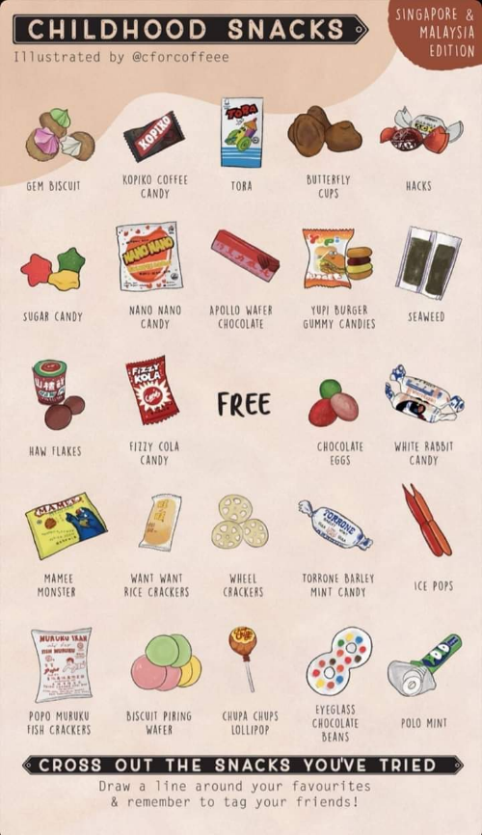
What is National Day Gamification
National Day Gamification was initiated by the Sephora team for the National Day Parade. The game will be a round-robin voting method which consists of 12 childhood snacks to be fighting for the first position for 4 weeks that will happen in their Mobile In-App Message:
1st week - participants would be voting for the top 8 snacks over the 12 childhood snacks that will proceed to the next round.
2nd week - participants would be voting for the 4 snacks over the top 8 snacks from the 1st week that will proceed to the next round.
3rd week - participants would be voting for the 2 snacks over the 4 snacks from the 2nd week that will proceed to the final round.
4th week - participants would be voting for the winning snack over the 2 snacks from the 3rd week.
Each participant will be able to redeem products from Sephora according to their votes, a total of 3 products to be redeemed if the criteria is met.
58 Beauty Pass Points - if the participants voted once, 58 Beauty Pass Points can be redeemed.
Sephora Canvas Bag - if the participants voted twice or more, Sephora Canvas Bag can be redeemed.
Hush Candle in Lavender- if the participants voted for the winning snack in the final round, Hush Candle in Lavender can be redeemed.

Slide 3
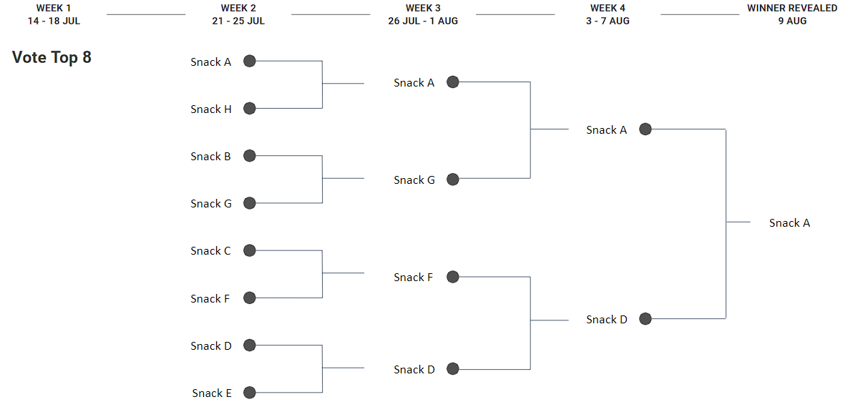
Technical Requirements
Tasks
Campaign Schedule
Sephora | Ematics
Business Requirements Creative Design & Copy-Writing | Game build The LIVE voting system List format 1v1 battle format Data record Data connection between Braze & SFMC Improve journey to credit Beauty Pass points
Game testing (start testing Week of 26 Jun)
Game Launch (12 July)
To build the voting system
Able to collate voting results real time
Able to render voting results in front end
Data extraction
Beauty Pass Points allocation
Able to allocate beauty pass points as rewards to all voting participants
Allocation is as real time as possible
Play status and play count
Able to map out who has voted 3 times & how often can the list be updated
Able to map out who are in the final winner snack pool

Slide 4
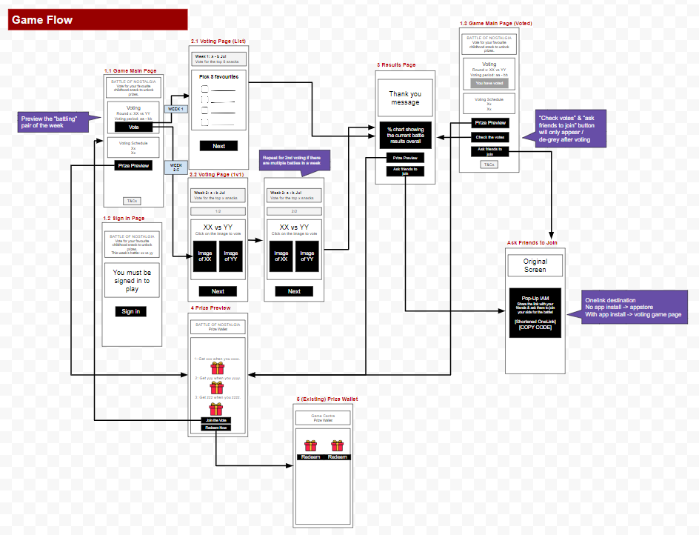

Slide 5
Execution

Slide 6






Braze is a marketing tool that users has limited access to data for security purposes, for that reason, Salesforce Marketing Cloud has been used to store and return data as needed, using In-App messaging, Braze can display full webpage including CSS, HTML, and JavaScript in the mobile application, and through those functionalities, the project was able to be done. Through the help of Salesforce Marketing Cloud, Cloud page functionality was used to help communicate with the HTML in braze to pass and return a data as needed, making it an API Endpoint, to list those endpoints:
When the user opens the In-app message in Sephora mobile application, Braze will communicate with the cloud page to check if the user has already (voted or not/redeemed the prize or not) on its current game week, If the user has already voted, the button will show “You have already voted” with gray background, else, the button will show “Vote Now”.
When the user clicks the “Vote Now” button. Braze will ask SFMC to return the products that is available for voting, the products return will depend on what game week is being played, if the its game week 1, then all the 12 products will be returned and user will vote for the user’s 8 preferred products, if week 2, 8 products from the winning products of week 1 will be returned, if week 3, 4 products from the winning products of week 2, if week 4, 2 products from the winning products of week 3.
When the user submitted the vote, the selected products will be submitted to SFMC and will be processed to return the total votes and percentage for each product that will be displayed in the thank you page of the HTML voting system in Braze.
When the user clicks the “View Prize” button in the Landing page, Braze will request user’s prize data from SFMC which will return user’s redemption data, be displayed in the prize page, and have “Already redeemed” gray button if the prize has been redeemed already, and “Redeem” button if not.
When the user clicks the “Redeem” button, SFMC will add the user’s data confirming that it has been redeemed by the user already.
When the user clicks the “View Current Result” in the Landing page, Braze will request the current score in SFMC, and it will return the total votes and percentage of each product according to the game week.

Slide 7
Scenario

Slide 8
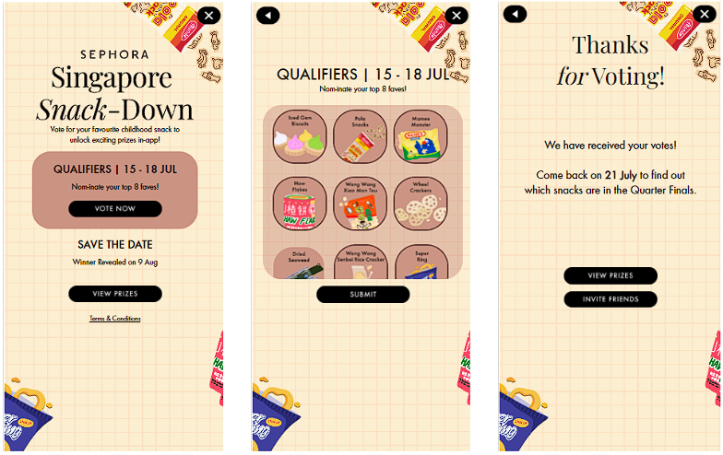
Week 1

Slide 9
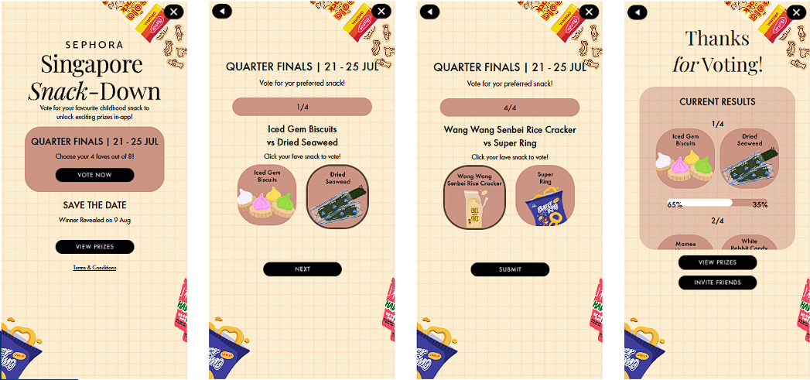
Week 2

Slide 10
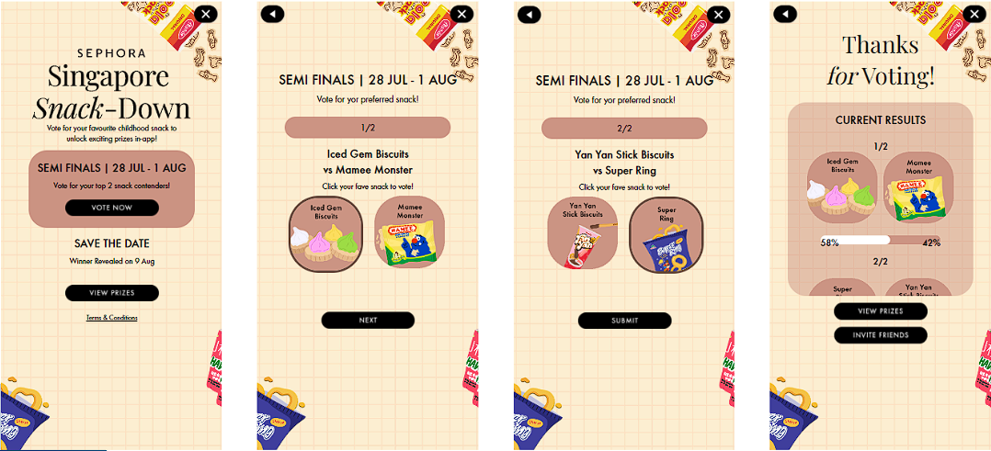
Week 3

Slide 11
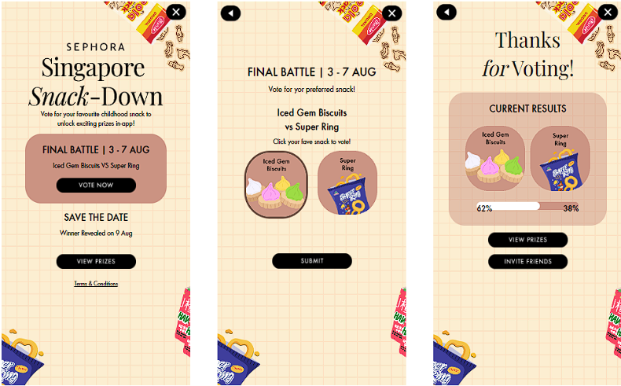
Week 4

Slide 12
Final Result

Slide 13
Issues

Slide 14
Users were able cast week4 votes during week 1
Week4 vote is the final round of the game and happened on 3-7 Aug, however, between the Week1 and Week2 vote round which is 19-20 July, users were able to submit a week4 votes, that instead of playing voting for the top 8 products over the 12 products shown, the user saw the 1v1 product instead, but how did that happen?
Each round happens at a given time - Week1(14-18 Jul), Week2(21-25 Jul), Week3(26 Jul-1 Aug), Week4(3-7 Aug), Winner Reveal(9 Aug) - in each round, there is a waiting time, however, is hasn’t been put into consideration and so all the triggers referred only to the dates of each week.
This didn’t explain why the users we’re able to vote for the Week4 while the user is in the waiting time between Week1 and Week2. Yes it didn’t, but as I explained, the waiting time hasn’t been put into consideration, what’s been put into consideration is the Week4, why? Because it’s the final round and no round after that, so I set the Week4 as default so even if the date is beyond the Week4 game date, the round will still be Week4
This also contributes to the issue, even if we didn’t set the Week4 as default, the user shouldn’t still be able to vote for the Week4 since you need to vote for all the weeks to determine what will be the products to vote for in the final round, however, during the testing, we agreed to not delete the test data since the test data is a very small number compare to the users who would be voting for the weeks to come and it sounds right, however, in the testing, Week4 has also been tested which means that the percentage of the product votes for each week has been decided already which came up to have a product to test for the Week4, and that caused the issue.
Solution: In each waiting time of every round, we’ve set a different display for the users that they won’t be able to vote during the waiting time, and for the testing, we’ve deleted the test data since it affects the total percentage of votes which causes the total vote percentage to not reach a 100% total.

Slide 15
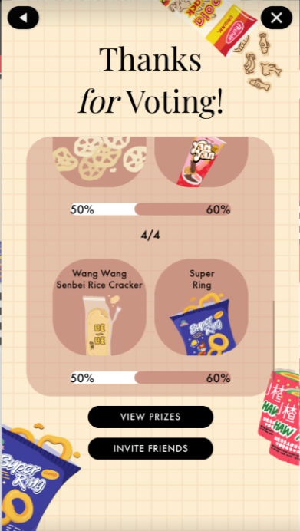
Total vote percentage exceeding a total of 100%
Before the Week2 vote has ended - 25 Jul, Sherice raised an issue regarding the percentage going beyond 100% in total votes for each 1v1 product, how did that happen?
Based on my investigation, the issue happened because of the limitation of Ampscript which Looks up to only a maximum of 2000 rows, but how could you explain what happen in the image?
Let’s say 1500 users voted for Wang wang Senbei Rice Cracker and 1300 users voted for Super Ring, if we’re gonna compute that, we need to refer to the limit of Ampscript:
1500/2000 * 100 = 75%
1300/2000 * 100 = 65%
That’s the logic of the issue in this image.
Solution: Since Ampscript has a limitation in terms of the Lookup function to make the report real-time, we changed the computation to every 15 minutes delay instead, with the help of Automation Studio, and using a Query doesn’t limit the rows return so we could compute the total percentage:
1500/2800 * 100 = 53.6%
1300/2800 * 100 = 46.4%

